Slide 1

BANK LOAN CASE STUDY

Slide 2
PROJECT DESCRIPTION:
Overview:
The project aims to analyze various factors influencing bank loan approvals. The study's primary focus is to identify key variables that significantly impact loan decisions, understand the relationships between these variables, and provide actionable insights to optimize the loan approval process.
Objectives:
1. Identify Key Factors: Determine the most influential variables that affect loan approval
decisions.
2. Analyze Relationships: Explore the correlations between different variables to
understand their interplay.
3. Improve Decision-Making: Provide insights and recommendations to improve the
efficiency and fairness of the loan approval process.

Slide 3
Approach:
1. Data Collection:
- Gathered a comprehensive dataset of loan applicants, including demographic
details, financial information, and loan specifics.
- Ensured data quality by cleaning and preprocessing the dataset, handling missing
values, and addressing any inconsistencies.
2. Exploratory Data Analysis (EDA):
- Conducted EDA to gain initial insights into the dataset.
- Visualized the distribution of key variables and identified patterns and trends.
- Utilized heatmaps to visualize correlation coefficients between variables, helping to
pinpoint significant relationships.
3. Insights and Recommendations:
- Interpreted the results to draw actionable insights.
- Provided recommendations to the bank on how to streamline the loan approval
process, reduce default risks, and improve customer satisfaction.
By following this systematic approach, the project aims to enhance the bank's ability to make informed loan approval decisions, ultimately leading to better financial outcomes for both the bank and its customers.

Slide 4
APPROACH :
Data Collection and Preparation:
- Data Sources: Collected historical loan data, including applicant demographics,
financial information, and loan details.
- Data Cleaning: Used Microsoft Excel 365 to address missing values, remove
duplicates, and handle outliers, ensuring a high-quality dataset.
Exploratory Data Analysis (EDA):
Objective: To gain initial insights, understand data distribution, and identify patterns.
Techniques:
- Descriptive Statistics: Summarized key metrics using Excel functions like
`AVERAGE`, `MEDIAN`, `SUM`, and `COUNT`.
- Visualizations: Created histograms, box plots, and scatter plots using Excel's built-in
chart tools to explore relationships and distributions.
- Heatmaps: Utilized Excel's conditional formatting to create heatmaps, visualizing
correlation coefficients between variables.

Slide 5
Feature Engineering:
Techniques:
- Creating New Variables: Based on domain knowledge, such as debt-to-income ratio.
- Binning: Grouped continuous variables into categories.
- Encoding Categorical Variables: Used Excel functions to convert categorical data into
numerical format.
-Normalization and Scaling: Applied Excel functions to standardize and normalize
numerical features for consistency.
Insights and Recommendations:
Objective: To draw actionable insights and provide recommendations.
Techniques:
- Feature Importance: Analyzed feature importance to understand key factors
influencing loan approvals.
- Visualization: Created charts and graphs in Excel to effectively communicate findings
and insights.
- Recommendations: Provided suggestions to optimize the loan approval process,
reduce default risks, and improve customer satisfaction.

Slide 6
Tools Summary:
- Microsoft Excel 365: Primary tool for data cleaning, EDA, feature engineering,
evaluation, and visualization.
By leveraging the capabilities of Microsoft Excel 365, this approach allowed for a comprehensive analysis of the factors influencing bank loan approvals, ultimately leading to data-driven insights and recommendations.

Slide 7
TECH-STACK USED:
1. Microsoft Excel 365:
Version: Microsoft Excel 365
Purpose:
- Data Collection and Cleaning: Used for importing, cleaning, and organizing the
dataset, handling missing values, and preparing the data for analysis.
- Exploratory Data Analysis (EDA): Performed initial data exploration, summary
statistics, and visualizations like histograms, box plots, scatter plots, and heatmaps
using Excel's built-in chart tools and conditional formatting.
- Feature Engineering: Created new variables, binned continuous variables, encoded
categorical variables
- Visualization and Presentation: Created charts and graphs to effectively
communicate findings and insights, and prepared final presentations.
By utilizing Microsoft Excel 365, we were able to efficiently manage, analyze, and
visualize the data, leading to actionable insights and recommendations for the bank
loan case study.

Slide 8
INSIGHTS:
Summary of Insights and Knowledge Gained:
During the Bank Loan Case Study project, several important insights and key findings were discovered. These insights provided a deeper understanding of the factors influencing loan approval decisions and highlighted meaningful trends and patterns within the data.
Key Findings:
1. Income and Loan Amount Correlation:
Higher-income applicants tend to receive larger loan amounts, suggesting that
income is a crucial factor in determining loan eligibility.
2. Age and Employment Duration:
Older applicants tend to have shorter employment durations. This trend may impact
loan approval decisions, as employment stability is often a key consideration.

Slide 9
3. Debt-to-Income Ratio:
Applicants with higher levels of debt relative to their income are less likely to be
approved for loans, highlighting the importance of financial stability in the approval
process.
4. Credit History and Loan Approval:
Applicants with a history of regular credit inquiries and responsible borrowing behavior
are more likely to be approved for loans.
5. Region Population and Loan Approval:
This trend may be due to better economic opportunities and higher financial activity in densely populated areas

Slide 10
6. Dependents and Loan Approval:
Applicants with more dependents are slightly less likely to be approved for loans,
possibly due to increased financial responsibilities.
TECHNIQUES AND TOOLS USED:
Microsoft Excel 365:
- Data Cleaning: Utilized Excel functions to handle missing values and ensure data
quality.
- Exploratory Data Analysis (EDA): Conducted EDA using descriptive statistics,
histograms, scatter plots, and heatmaps to identify key patterns and relationships.
- Correlation Analysis: Applied Excel's `CORREL` function and conditional formatting
to create a correlation matrix and visualize relationships between variables.
- Visualization: Created charts and graphs to effectively communicate findings and
insights.
These insights provide valuable information to optimize the bank's loan approval process, reduce default risks, and enhance customer satisfaction. By leveraging Microsoft Excel 365, the project successfully identified critical factors influencing loan approvals and provided actionable recommendations.

Slide 11
RESULT:
Achievements:
1. Identification of Key Variables:
- Successfully identified crucial factors influencing loan approval decisions, such as
applicant income, credit history, debt-to-income ratio, and number of dependents.
- Pinpointed correlations between these variables and their impact on loan outcomes.
2. Comprehensive Data Analysis:
- Conducted thorough exploratory data analysis (EDA) to uncover patterns and trends
within the data.
- Created visualizations such as histograms, scatter plots, and heatmaps to present
insights effectively.

Slide 12
3. Actionable Insights and Recommendations:
- Derived actionable insights from the analysis, leading to practical recommendations
for the bank.
- Suggested strategies to improve the loan approval process, reduce default risks, and
enhance customer satisfaction.
4. Enhanced Decision-Making:
- Provided the bank with data-driven insights to make informed decisions on loan
approvals.
- Enabled the bank to better understand the characteristics of applicants who are
likely to be approved or denied loans.

Slide 13
Contribution to Understanding:
- Deeper Insight into Loan Approval Factors:
- Gained a comprehensive understanding of the factors that significantly impact loan
approval decisions.
- Recognized the importance of financial stability, credit history, and demographic
factors in the loan approval process.
- Improved Analytical Skills:
- Enhanced proficiency in using Microsoft Excel 365 for data analysis and visualization.
- Developed skills in cleaning, organizing, and analyzing large datasets, as well as
interpreting complex statistical relationships.

Slide 14
- Data-Driven Decision Making:
- Emphasized the value of data-driven approaches in financial decision-making.
- Demonstrated how analytical techniques can optimize business processes and
improve outcomes.
- Practical Applications:
- Provided practical recommendations that can be directly applied by the bank to refine
their loan approval criteria and processes.
- Highlighted the importance of continuous data analysis to adapt to changing
economic conditions and applicant profiles.

Slide 15
PROPORTION OF MISSING VALUES
Used conditional formatting – new Rule – Format only cells that contain – format only that contain section –blanks –format
FUNCTIONS USED :
COUNT BLANK FUNCTION
=COUNTBLANK(A:A)
COUNTA FUNCTION
=COUNTA (A:A)
PERCENTAGE FUNCTION
=COUNTBLANK(A:A)/ (COUNT A(A:A) + COUNTBLANK(A:A))* 100
COUNT BLANK used to count the empty missing cells
COUNT A is used to count the total no of missing cells

Slide 16
The percentage of missing values is found to quantify the extent of missing data relative to the total no of entries for each variable
percentage function divides the no of missing values by the total no of cells and multiplies by 100
So I have found percentages of all values
So As by finding percentage of missing values I have found the proportion of the missing values

Slide 17
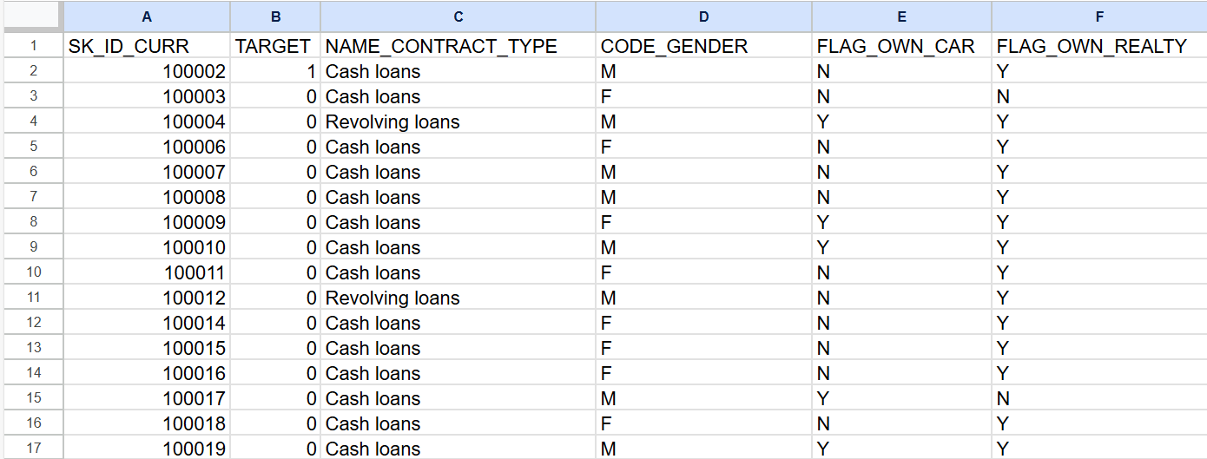
THE COLUMNS TAKEN TO FIND MISSING VALUES :

Slide 18
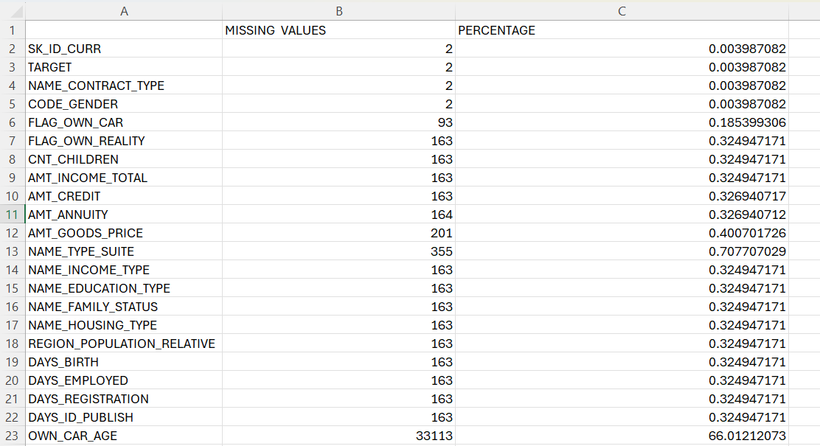
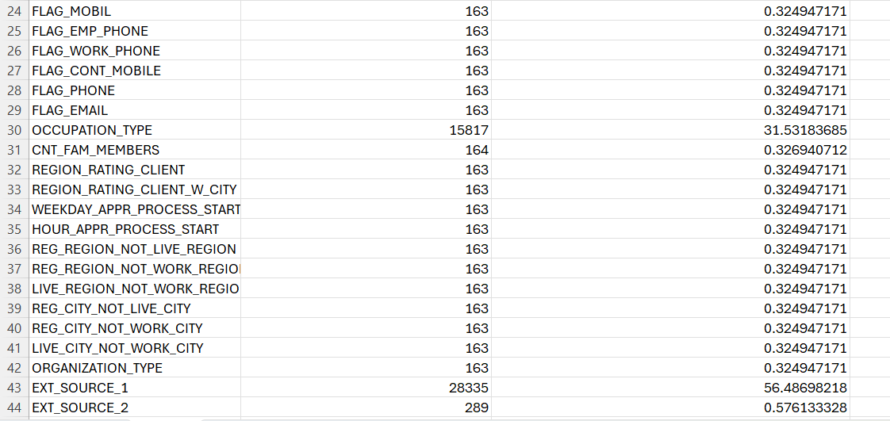
MISSING VALUES & PERCENTAGES

Slide 19
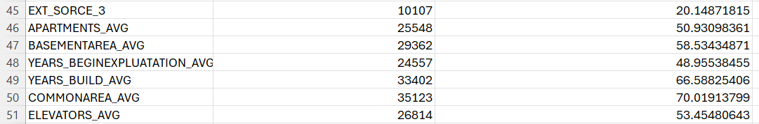
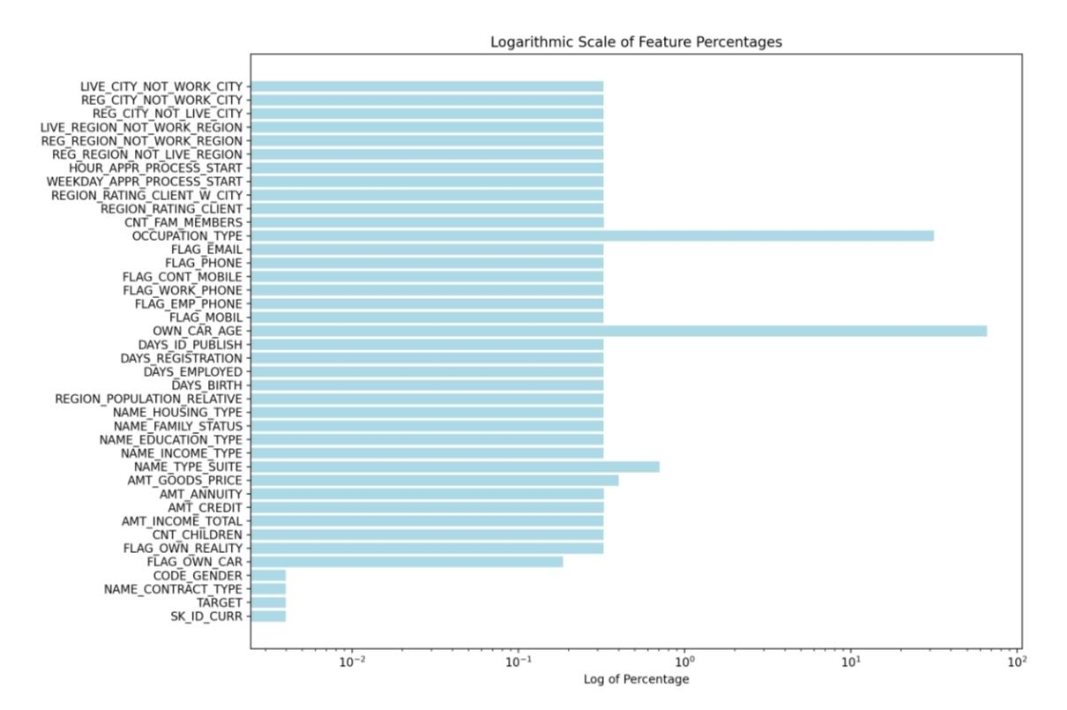
chart used to visualize the proportion of missing values for each variable is given below
Logarithmic scale is used for the percentage differences in the chart to be seen more clearly

Slide 20
DETECTING THE DISTRIBUTION OF OUTLIERS
To calculate Mean :
=AVERAGE(A2: A100)
To calculate standard deviation :
=STDEV.P (A2:A100)
z- score formula :
=(A2 - $B$1) / $B$2
To calculate Z-score I have subtracted mean from value and divide by standard deviation
i have found outliers using Z-score where values less than -3 and values greater than -3 are considered outliers
TheAMT_INCOME_TOTAL,AMT_CREDIT,AMT_ANNUITY,EXT_SOURCE_1,CNT_CHILDREN,
REGION_RATING_CLIENT,EXT_SOURCE_3 are the columns from the dataset where outliers were found.
To find if all the datapoints are valid or not I have used these below function for all columns
=IF(OR(A208<10000,A208>1000000),"INVALID","VALID")

Slide 21
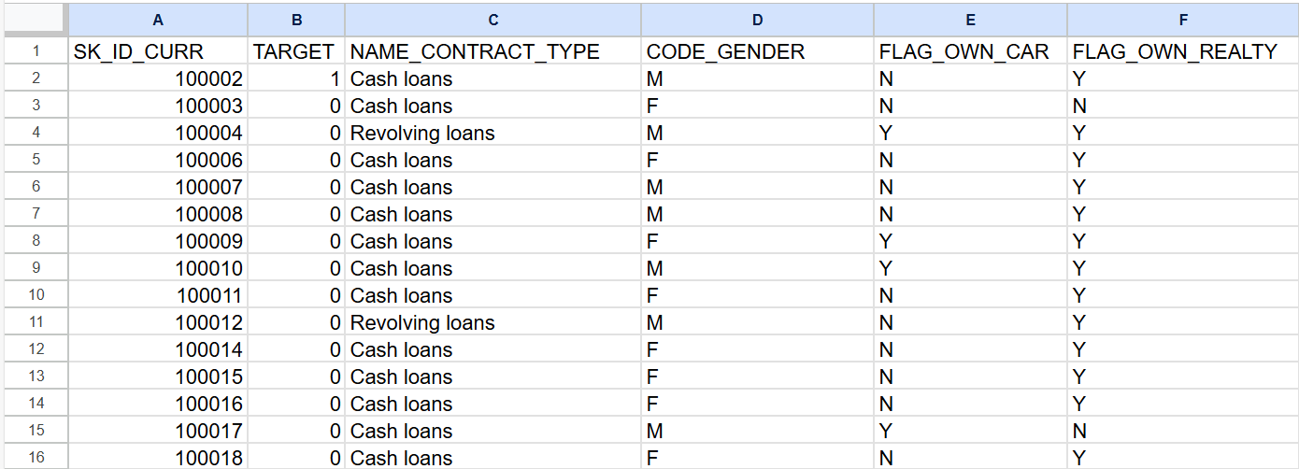
THE COLUMNS TAKEN TO FIND OUTLIERS

Slide 22
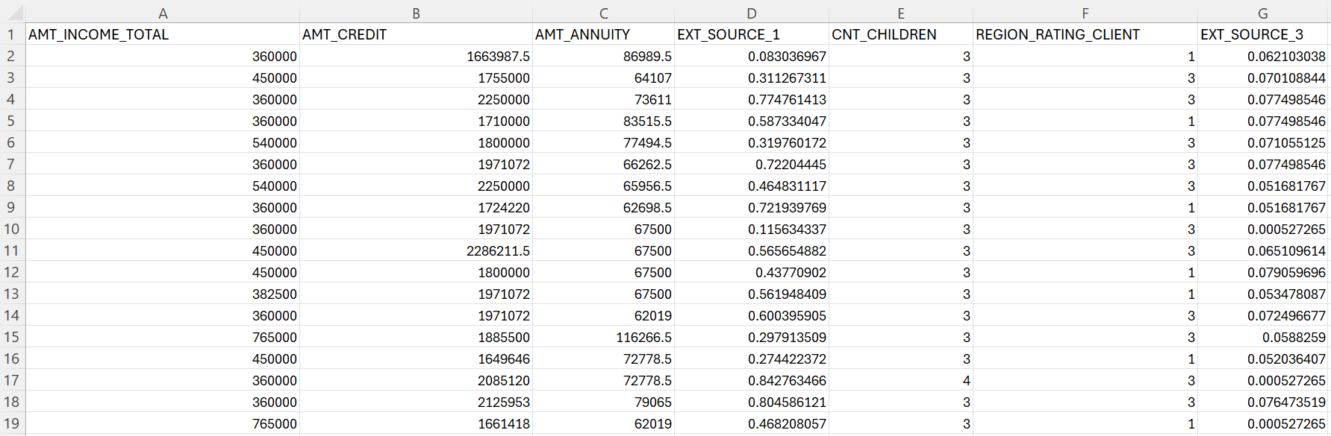
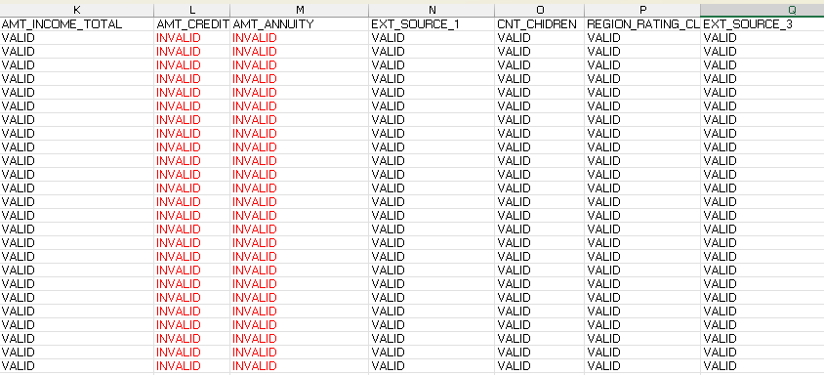
COLUMNS WHERE OUTLIERS ARE FOUND
THE VALID/INVALID DATA POINTS OF THE DATA
The Data points are used to plot the box plots

Slide 23
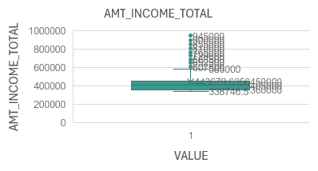
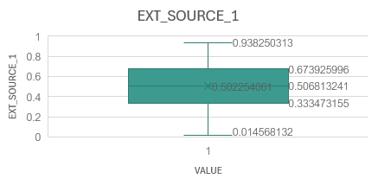
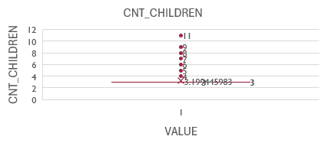
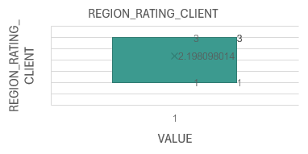
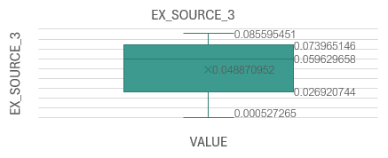
BOX PLOTS :

Slide 24
ANALYZING DATA IMBALANCE
The columns taken are :
code_gender,name_type_suite,name_income_type,name_education_type,
name_family_status,name_housing_type,occupation_type,organization_type,
housetype_mode,wallsmateal_mode,emergency state_mode
I have used countif function to calculate count of each category comparing to Target column
=COUNTIFS(A2:A50000,"1",B2:B50000,"M")

Slide 25
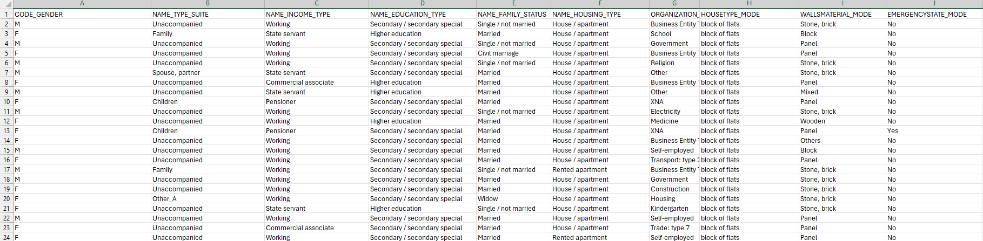
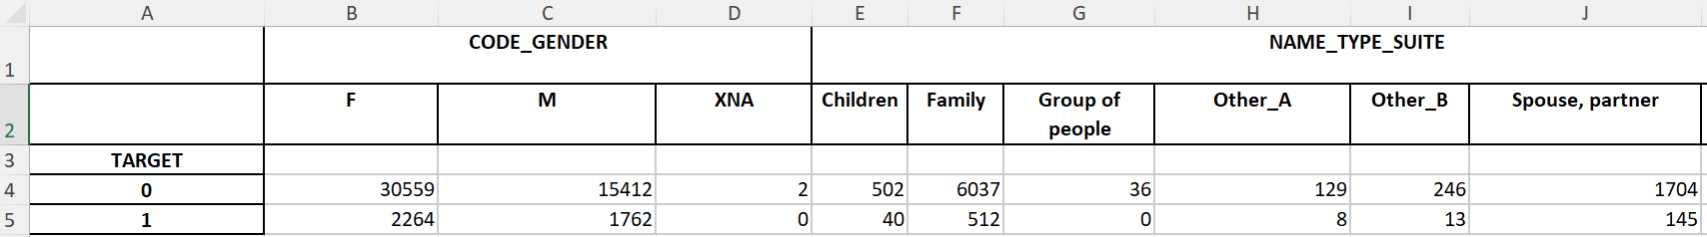
THE COLUMNS TAKEN TO FIND IMBALANCE
COUNT OF EACH CATEGORY COMPARING TO TARGET COLUMN

Slide 26
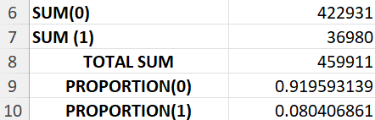
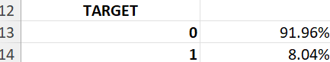
I have calculated the sum of target 0 and target 1 rows using sum function
=SUM(A1:A10)
I have calculated total of (sum of target 0 and target 1 rows ) using sum function
=SUM(A1:A10,B1:B10)
I have calculated proportions of target variable using proportion formula
=B6/B8
I have calculated the proportion of target 0 and target 1
I have calculated the ratio of data imbalance through the formula
Ratio of data imbalance = proportion of Majority value / proportion of Minority value
Majority value(target variable 0) = 0.919593139
Minority value (target variable 1) = 0.080406861
Ratio of data imbalance = 0.919593139 / 0.080406861 = 11.44
Then I have calculated the percentage of both target 0 & target 1 proportions

Slide 27
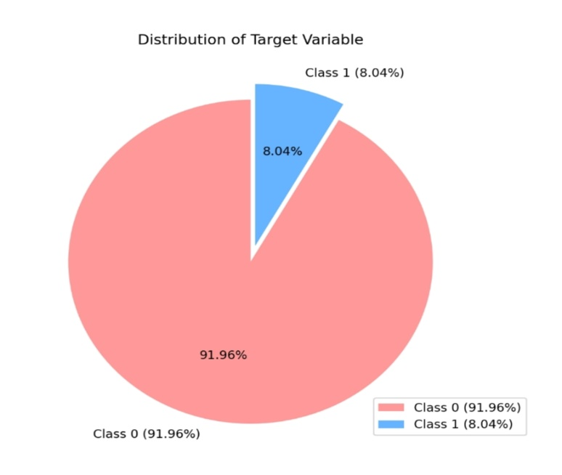
I have used a pie chart to display the distribution of target variable and highlighted the class imbalance
PIE CHART
DISTRIBUTION OF TARGET VARIABLE
NOTE: The chart indicates a ratio imbalance of 11.44,highlighting a significant disparity among the
target variables

Slide 28
UNIVARIATE ANALYSIS
For univariate analysis the columns AMT_INCOME_TOTAL, AMT_CREDIT, AMT_ANNUITY,
CNT_CHILDREN, DAYS_BIRTH, DAYS_EMPLOYED, AMT_ANNUITY, AMT_APPLICATION, AMT_CREDIT,
AMT_DOWN_PAYMENT, AMT_GOODS_PRICE, NAME_CONTRACT_TYPE, NAME_CONTRACT_STATUS are taken
For Descriptive analysis -
To find Count,Mean,Std,Minimum,Maximum,Median,Range,Mode,Percentage,Variance,quartile,percentile values These following functions are used :
1. COUNT FUNCTION:
=COUNT(A1:A50000)
2.MEAN FUNCTION:
=AVERAGE(A1: A50000)

Slide 29
3.STANDARD DEVIATION FUNCTION :
=STDEV.S(A1:A50000)
4.MINIMUM FUNCTION :
=MIN(A1:A50000)
5.MAXIMUM FUNCTION :
=MAX(A1:A50000)
6.RANGE FUNCTION :
=MAX(A1:A50000) – MIN(A1:A50000)
7.MODE FUNCTION :
=MODE(A1:A50000)
8.VARIANCE FUNCTION:
=VAR.S(A1: A50000)
9.QUARTILE FUNCTION:
Q1 = QUARTILE.INC(A1:A50000,1)
Q2 = QUARTILE.INC(A1:A50000,2)
Q3 = QUARTILE.INC(A1:A50000,3)
75th Percentile:
=PERCENTILE.INC(A1:A50000, 75/100)
90th Percentile :
=PERCENTILE.INC(A1:A50000, 90/100)
95th Percentile:
=PERCENTILE.INC(A1:A50000, 95/100)
99th Percentile:
=PERCENTILE.INC(A1:A50000, 99/100)
Percentage was also found for all columns
10.PERCENTILE FUNCTION:
1st Percentile:
=PERCENTILE.INC(A1:A50000, 1/100)
5th Percentile :
=PERCENTILE.INC(A1:A50000, 5/100)
10th Percentile:
=PERCENTILE.INC(A1:A50000,
10/100)
25th Percentile:
=PERCENTILE.INC(A1:A50000,
25/100)
50th Percentile :
=PERCENTILE.INC(A1:A50000, 50/100)

Slide 30
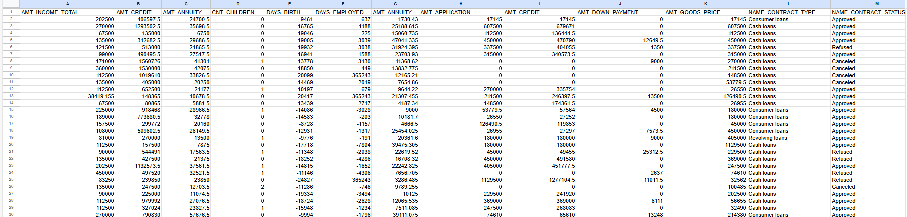
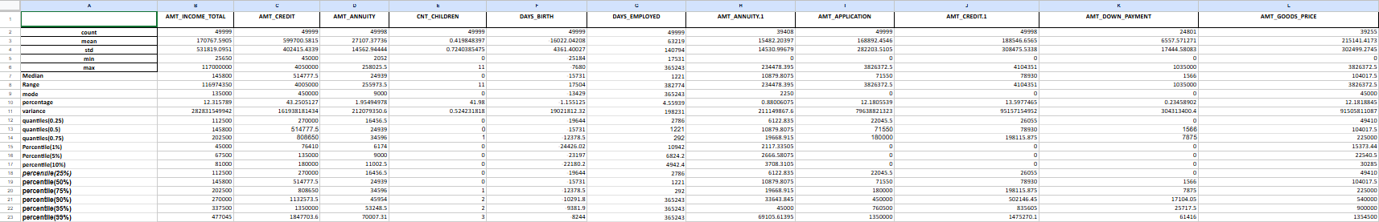
COLUMNS TAKEN TO PERFORM UNIVARIATE ANALYSIS
DESCRIPTIVE ANALYSIS OF THE COLUMNS

Slide 31
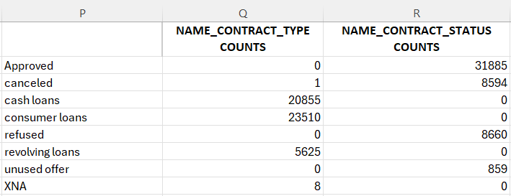
COUNTS CALCULATED FOR CATEGORIAL COLUMN
I have used histograms and bar chart to show distribution of individual variable

Slide 32
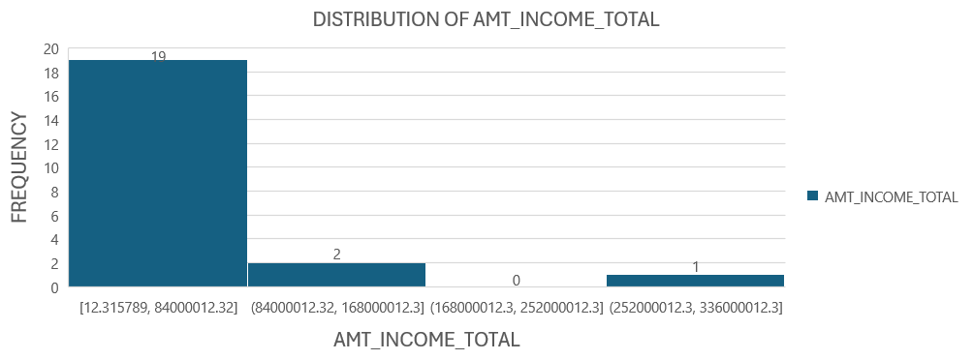
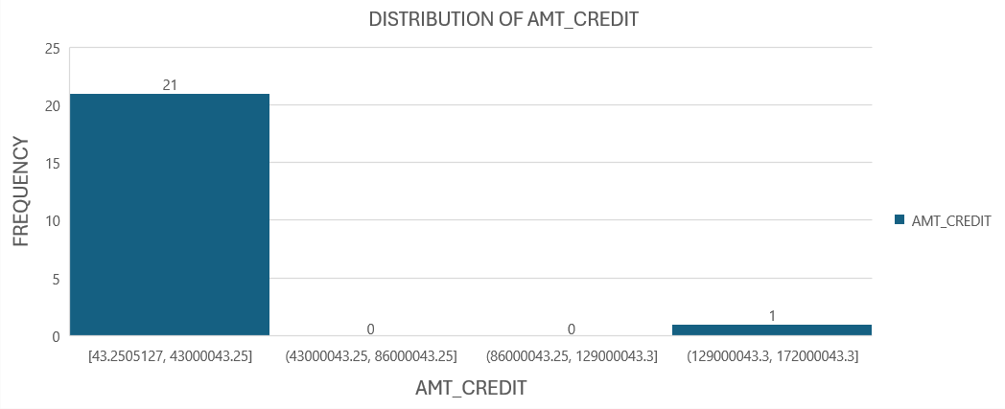
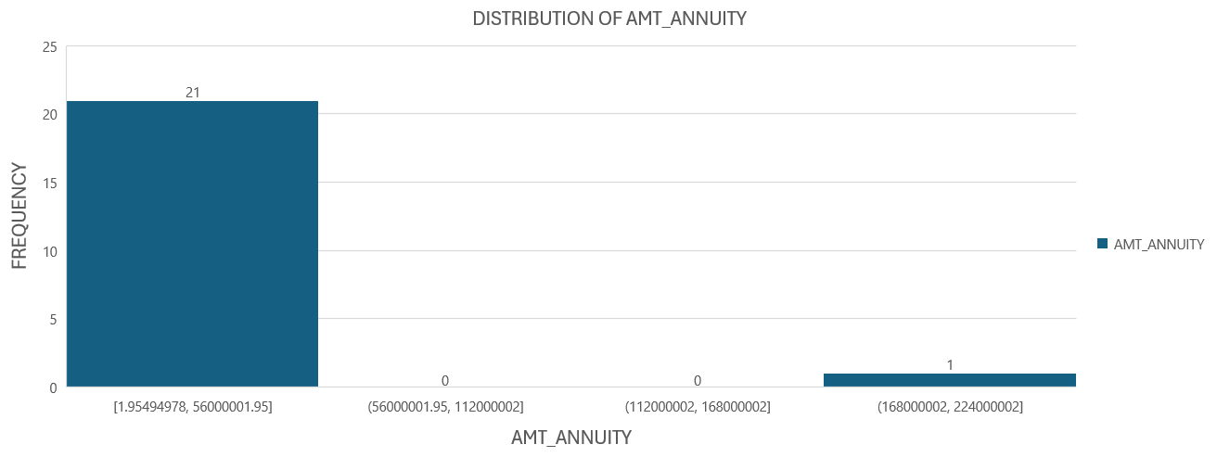
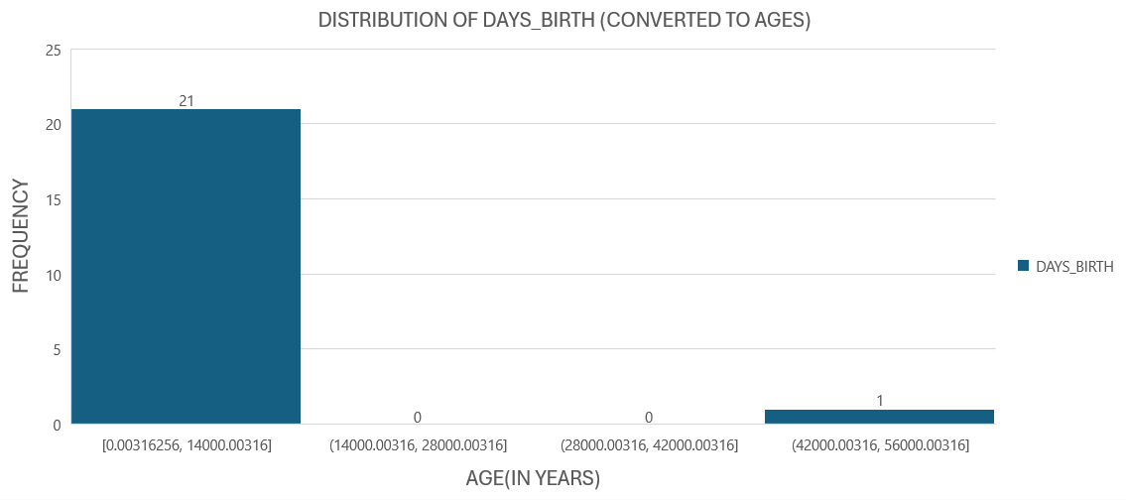
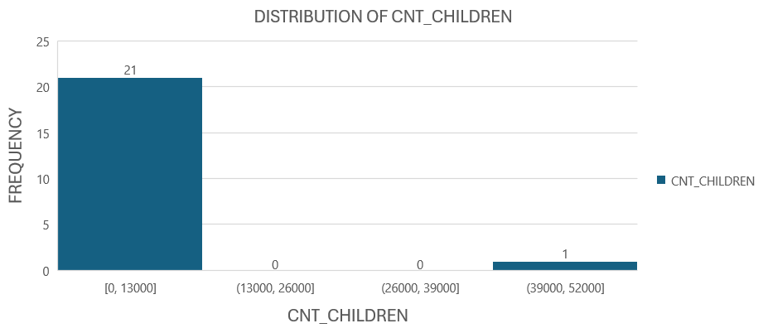
HISTOGRAMS :
DAYS_BIRTH column is converted to years for positive values on X – Axis
The formula used to convert age in days into age in years :
= the age value / 365.25

Slide 33
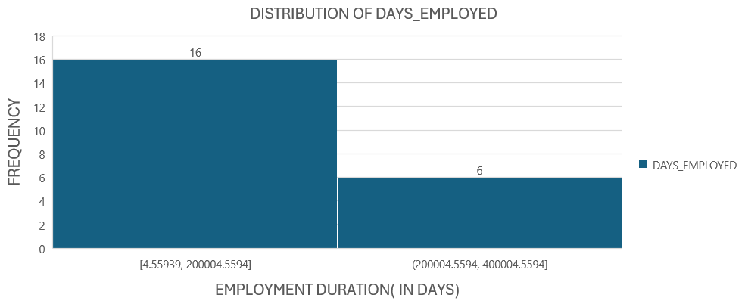
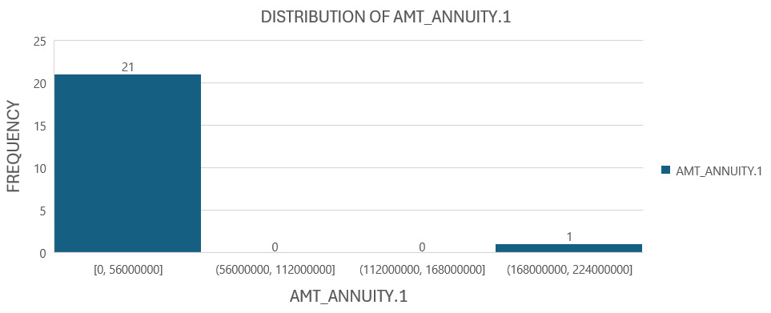

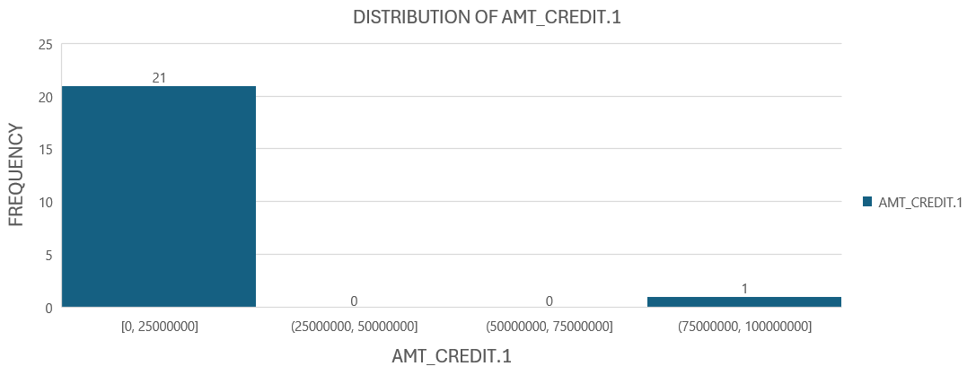
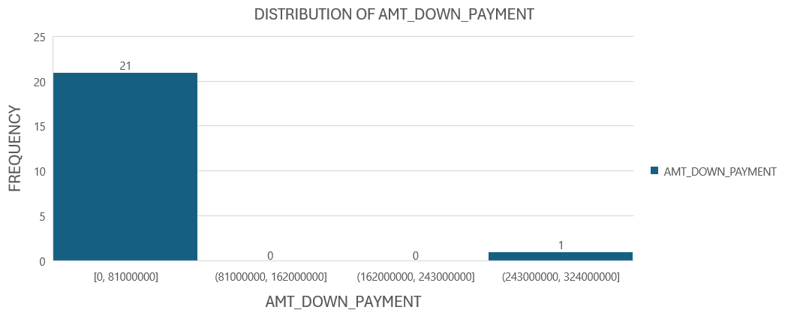
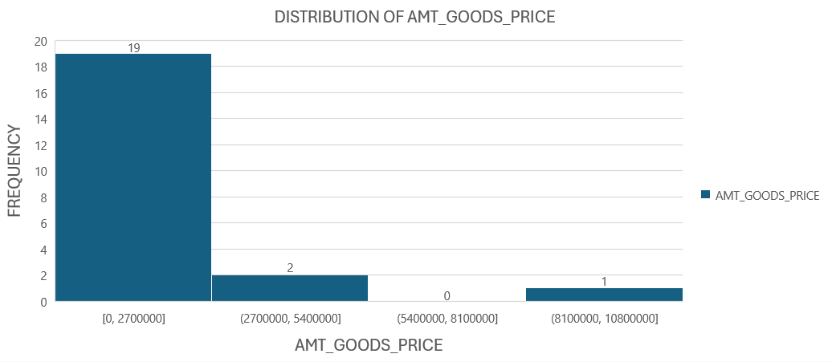

Slide 34
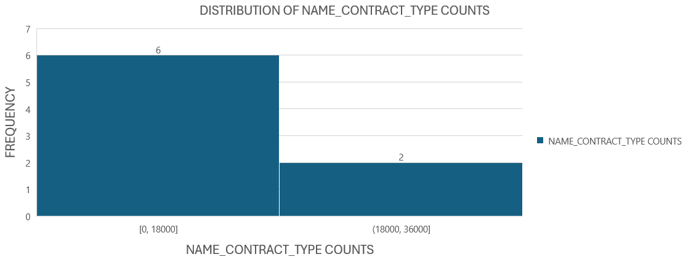
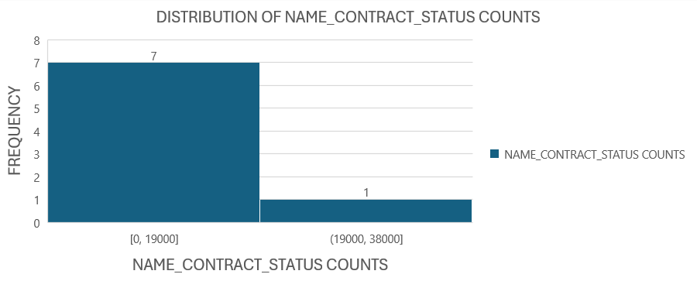
DISTRIBUTION OF VARIABLE COUNTS

Slide 35
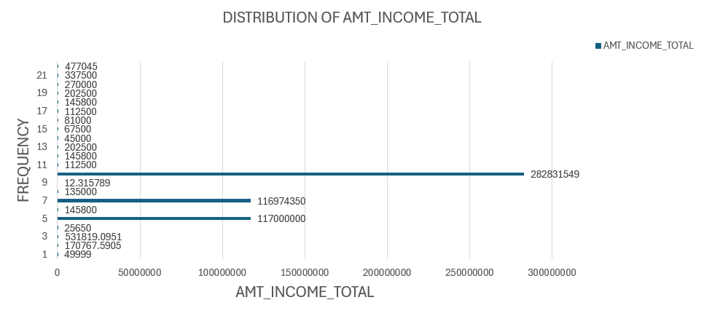
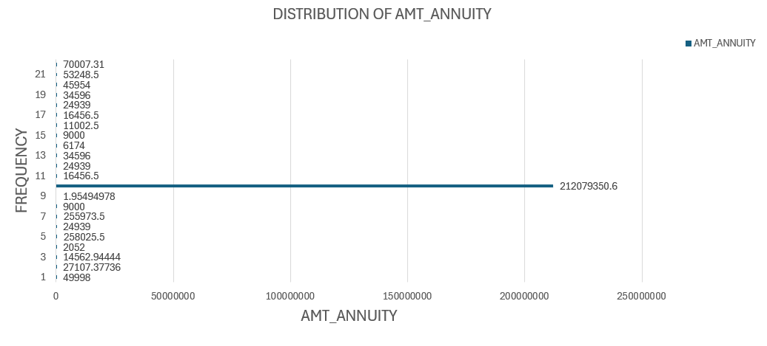
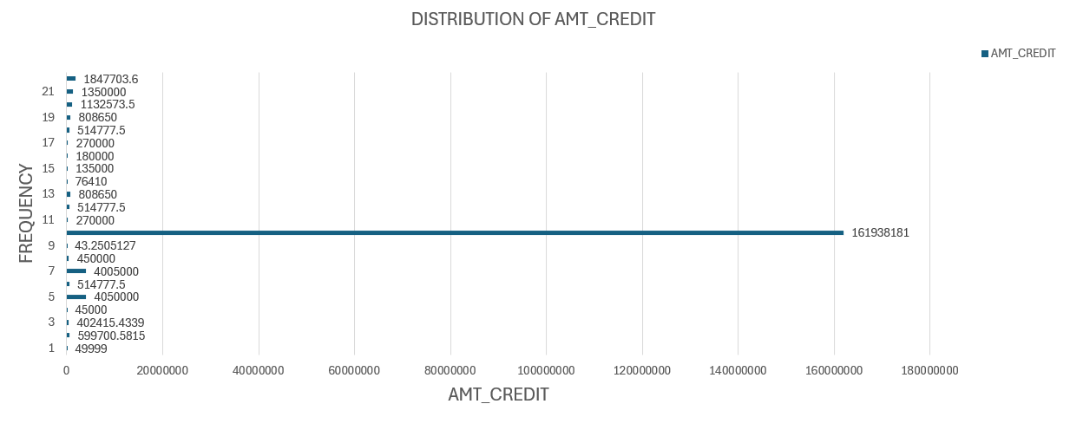
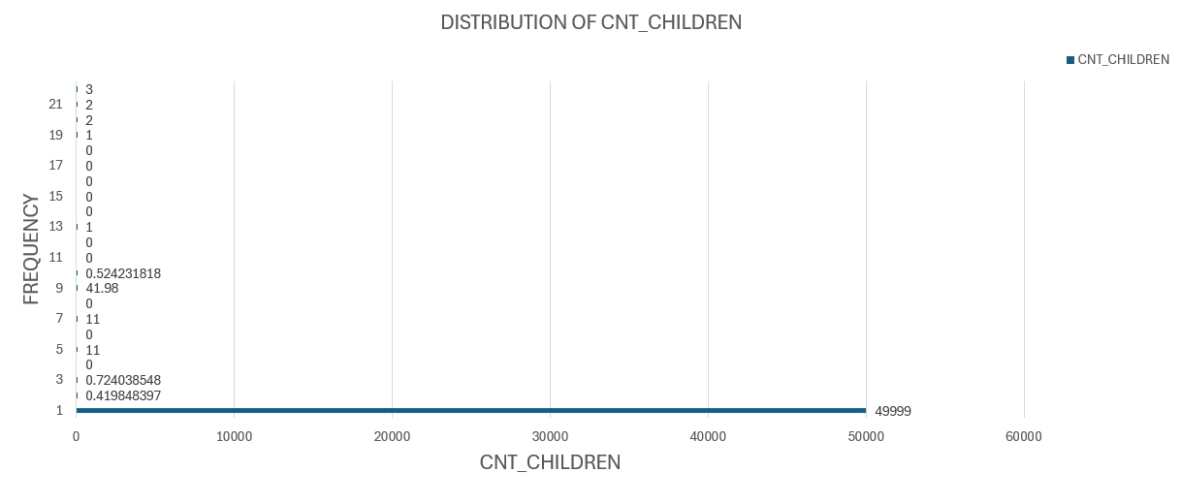
BAR CHARTS :

Slide 36
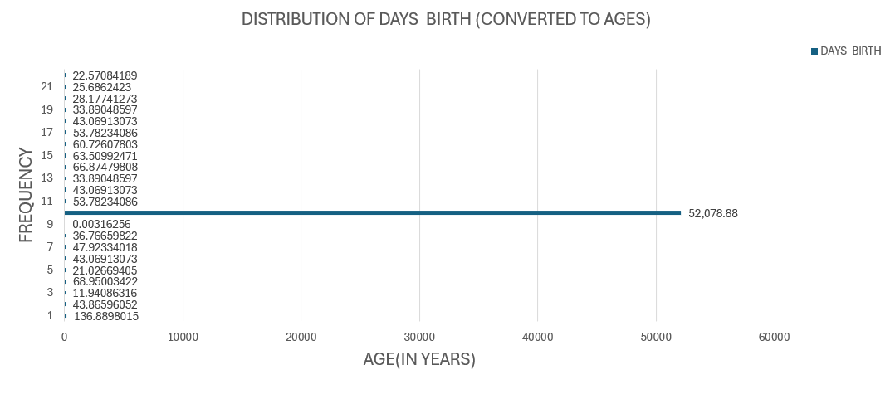
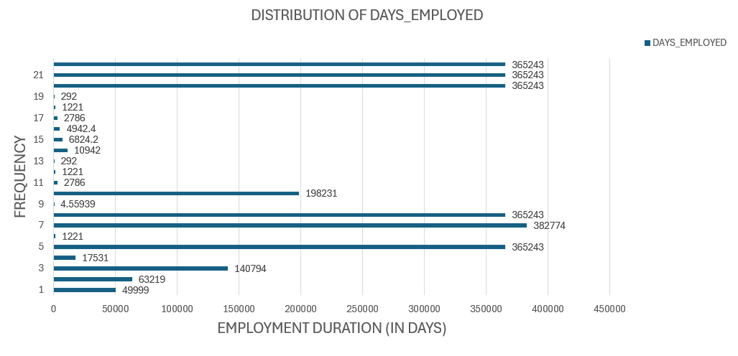
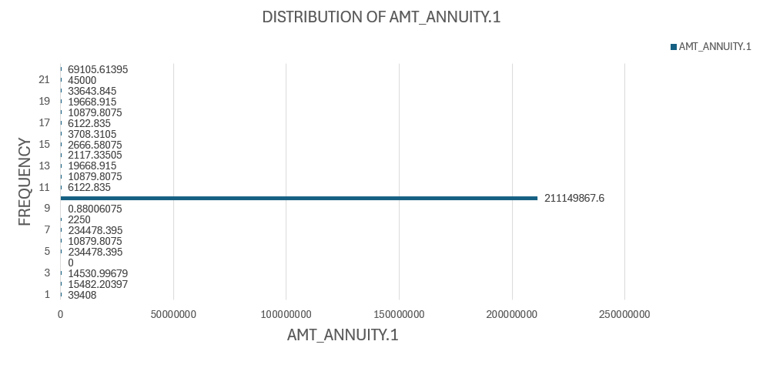
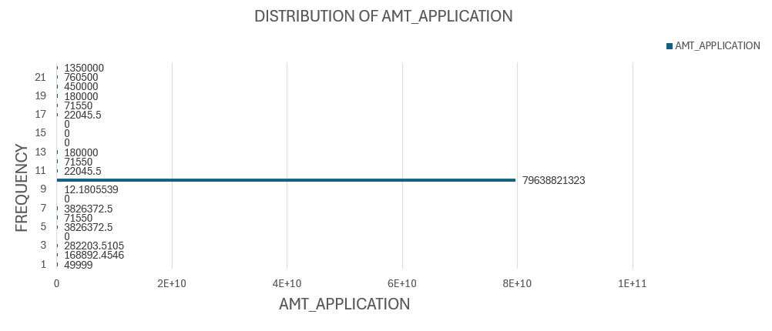
DAYS_BIRTH column is converted to years for positive values on X – Axis
The formula used to convert age in days into age in years :
= the age value / 365.25

Slide 37
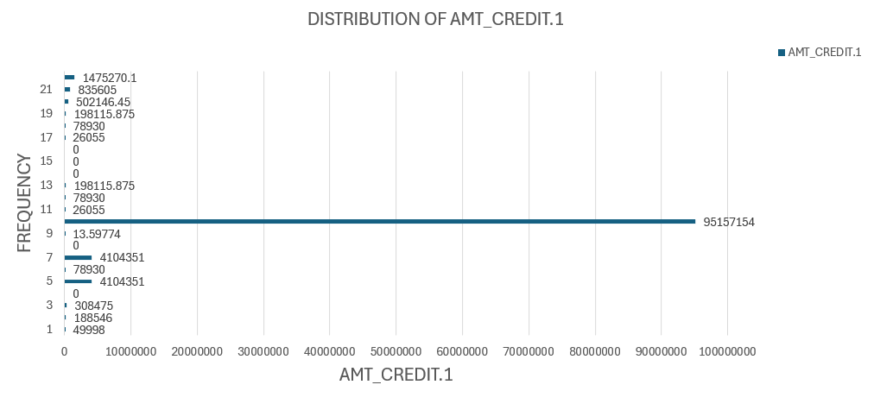
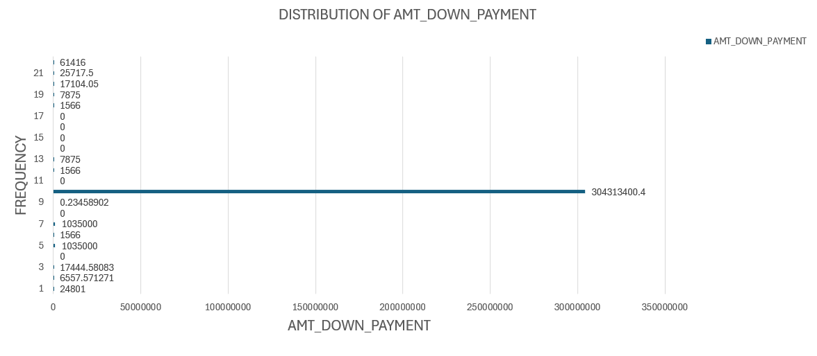
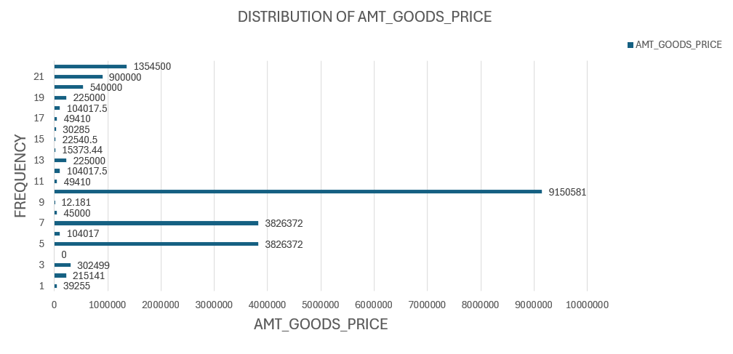

Slide 38
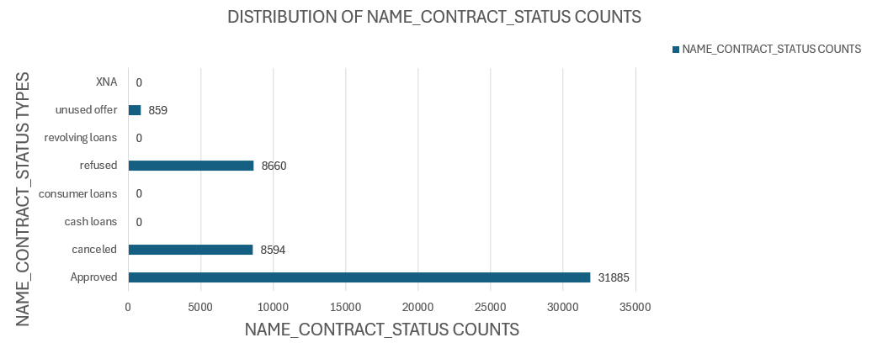
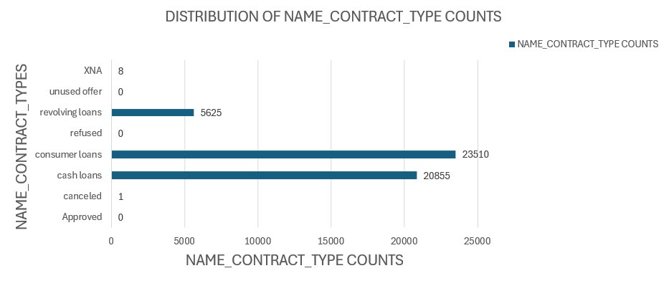
DISTRIBUTION OF VARIABLE COUNTS

Slide 39
SEGMENTED UNIVARIATE ANALYSIS
For Segmented univariate Analysis the columns CODE_GENDER, NAME_INCOME_TYPE,
NAME_EDUCATION_TYPE, NAME_FAMILY_STATUS, NAME_CLIENT_TYPE,
NAME_PAYMENT_TYPE, CHANNEL_TYPE, NAME_CONTRACT_TYPE,
NAME_CONTRACT_TYPE.1, OWN_CAR_AGE are taken
The Segments chosen are given below :
1) CODE_GENDER segmented by NAME_INCOME_TYPE
2) NAME_INCOME_TYPE segmented by NAME_EDUCATION_TYPE
3) NAME_EDUCATION_ TYPE segmented by NAME_FAMILY_STATUS
4) NAME_FAMILY_STATUS segmented by NAME_CLIENT_TYPE
5) NAME_CLIENT_TYPE segmented by NAME_PAYMENT_TYPE
6) NAME_PAYMENT_TYPE segmented by CHANNEL_TYPE
7) NAME_CONTRACT_TYPE segmented by CHANNEL_TYPE
8) NAME_CONTRACT_TYPE segmented by CODE_GENDER
9) NAME_CONTRACT_TYPE.1 segmented by OWN_CAR_AGE
10) OWN_CAR_AGE segmented by CODE_GENDER

Slide 40
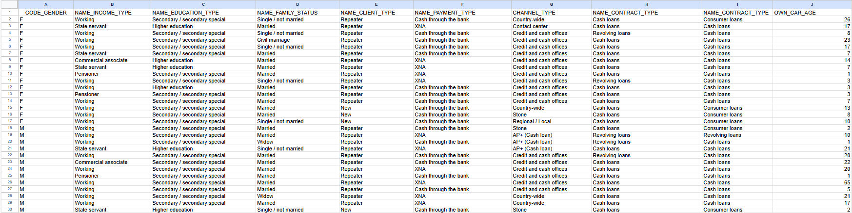
COLUMNS TAKEN TO PERFORM SEGMENTED ANALYSIS

Slide 41
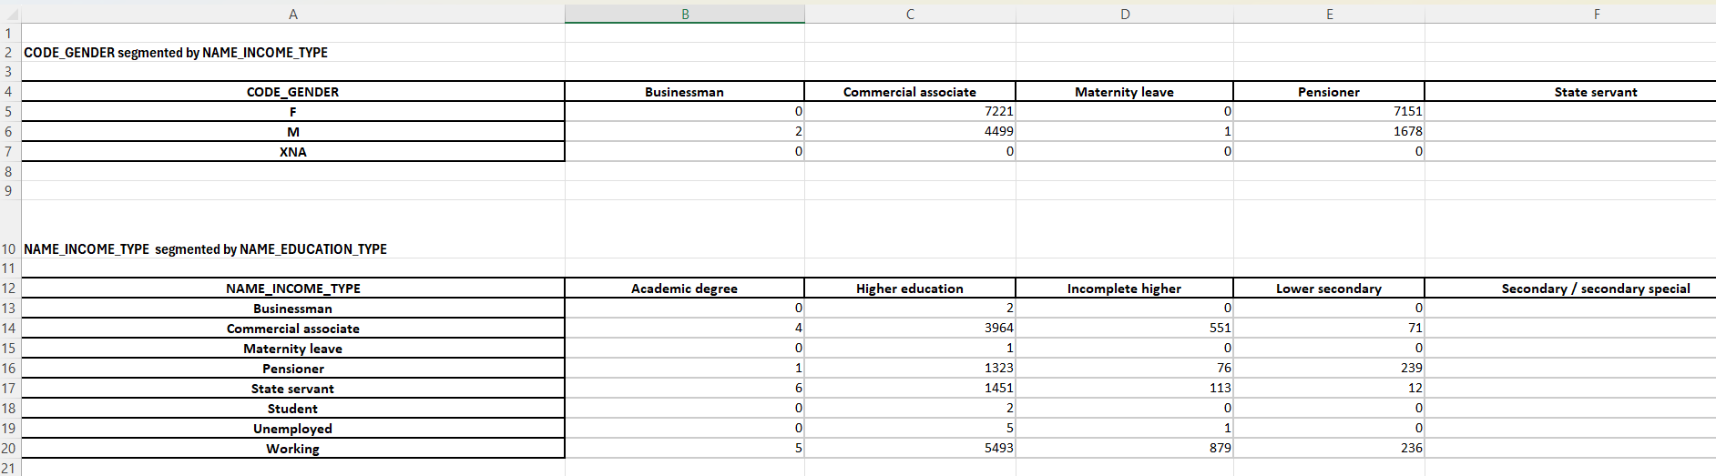
SEGMENTS WHICH ARE FOUND
These segments are done using pivot table

Slide 42
For Descriptive analysis -
To find Count,Mean,Std,Minimum,Maximum,Median,Range,Mode,Percentage,Variance,quartile,percentile values These following functions are used :
1. COUNT FUNCTION:
=COUNT(A1:A50000)
2.MEAN FUNCTION:
=AVERAGE(A1: A50000)

Slide 43
3.STANDARD DEVIATION FUNCTION :
=STDEV.S(A1:A50000)
4.MINIMUM FUNCTION :
=MIN(A1:A50000)
5.MAXIMUM FUNCTION :
=MAX(A1:A50000)
6.RANGE FUNCTION :
=MAX(A1:A50000) – MIN(A1:A50000)
7.MODE FUNCTION :
=MODE(A1:A50000)
8.VARIANCE FUNCTION:
=VAR.S(A1: A50000)
9.QUARTILE FUNCTION:
Q1 = QUARTILE.INC(A1:A50000,1)
Q2 = QUARTILE.INC(A1:A50000,2)
Q3 = QUARTILE.INC(A1:A50000,3)
75th Percentile:
=PERCENTILE.INC(A1:A50000, 75/100)
90th Percentile :
=PERCENTILE.INC(A1:A50000, 90/100)
95th Percentile:
=PERCENTILE.INC(A1:A50000, 95/100)
99th Percentile:
=PERCENTILE.INC(A1:A50000, 99/100)
Percentage was also found for all columns
10.PERCENTILE FUNCTION:
1st Percentile:
=PERCENTILE.INC(A1:A50000, 1/100)
5th Percentile :
=PERCENTILE.INC(A1:A50000, 5/100)
10th Percentile:
=PERCENTILE.INC(A1:A50000,
10/100)
25th Percentile:
=PERCENTILE.INC(A1:A50000,
25/100)
50th Percentile :
=PERCENTILE.INC(A1:A50000, 50/100)

Slide 44
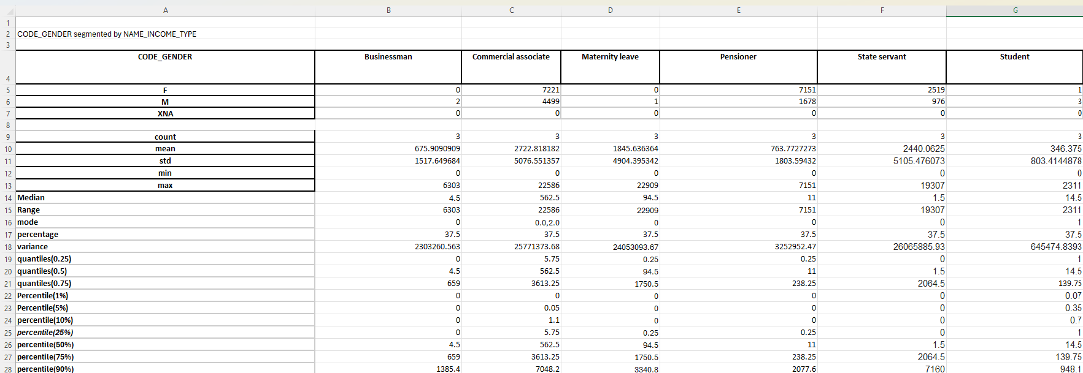
SEGMENT’S DESCRIPTIVE ANALYSIS
The bar charts are plotted to compare variable distributions across different scenarios

Slide 45
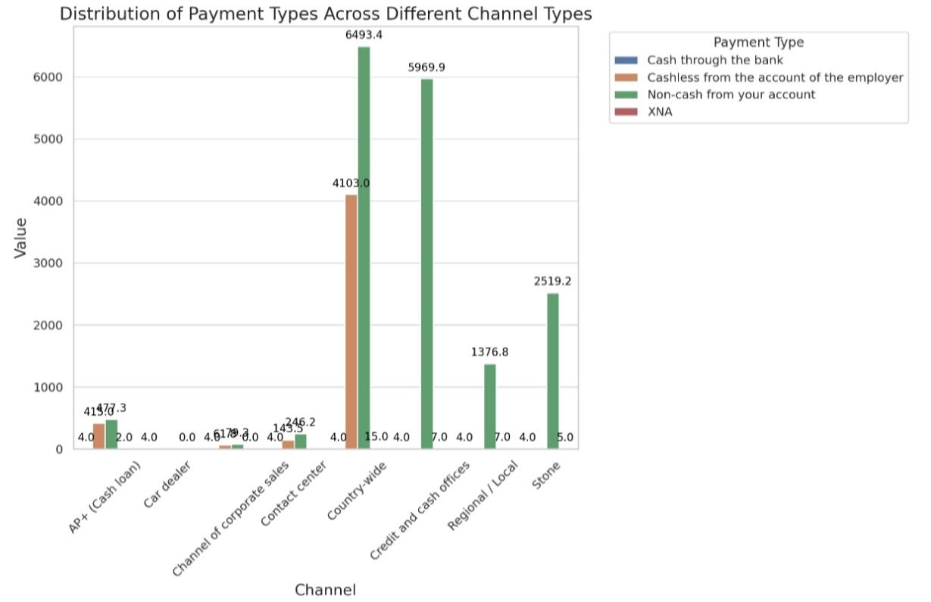

BAR CHARTS :

Slide 46



Slide 47



Slide 48



Slide 49



Slide 50
BIVARIATE ANALYSIS
For Bivariate analysis the columns AMT_CREDIT , NAME_CONTRACT_TYPE .1, AMT_APPLICATION,
AMT_CREDIT 1, AMT_INCOME_TOTAL, TARGET, AMT_DOWN_PAYMENT are taken
The Segments chosen are given below :
1) AMT_CREDIT segmented by AMT_CREDIT_1
2) APPLICATION_AMT segmented by TARGET
3) INCOME_TOTAL segmented by DOWN_PAYMENT
4) INCOME_TOTAL segmented by TARGET
5) CREDIT_AMT segmented by INCOME_TOTAL
6) DOWN_PAYMENT segmented by APPLICATION_AMT
7) CREDIT_AMT_1 segmented by DOWN_PAYMENT
8) CONTRACT_TYPE_1 segmented by TARGET

Slide 51


COLUMNS TAKEN TO PERFORM BIVARIATE ANALYSIS
SEGMENTS WHICH ARE FOUND
These segments are done using pivot table

Slide 52

The Correlation Analysis is done to each of the segment’s output found using pivot table
To find Correlation Coefficient I have used the CORREL() Function :
= CORREL( A5 : A9 , B5 : B9 )
AMT_CREDIT SEGMENTED BY AMT_CREDIT_1
The Correlation between amt_credit_1 & amt_credit : -0.984
Indicating a negative correlation between the two variables suggesting that as the amt_credit_1 increases the amt_credit tends to decrease

Slide 53


APPLICATION_AMT SEGMENTED BY TARGET
The Correlation between Application_amt & target : -0.2955118903717489
Indicating a negative correlation between the two variables suggesting that as the amt of application increases the target variable tends to decrease
INCOME_TOTAL SEGMENTED BY DOWN_PAYMENT
The Correlation between AMT_Income_Total & Down_payment : -0.707
Indicating a strong negative correlation between the two variables suggesting that as the down payment increases the total income tends to decrease

Slide 54


INCOME_TOTAL SEGMENTED BY TARGET
The Correlation between Income_Total & Target : - 0.9999999999999999
Indicating a negative correlation between the two variables suggesting that as the income_total decreases, the target value increases or vice versa
CREDIT_AMT SEGMENTED BY INCOME_TOTAL
The Correlation between Credit_amt & Income_Total : -0.3992454827590575
Indicating a negative correlation between the two variables suggesting that as the income increases the credit amount tends to decrease

Slide 55


DOWN_PAYMENT SEGMENTED BY APPLICATION_AMT
The Correlation between Down_payment & Application_Amt : -0.9376
Indicating a negative correlation between the two variables suggesting that as the application_amt increases the amt_down_payment tends to decrease and vice versa
CREDIT_AMT_1 SEGMENTED BY DOWN_PAYMENT
The Correlation between Down_payment & Credit_amt_1 is -0.7071
Indicating a negative correlation between the two variables suggesting that as the Down_payment increases the credit_amt_1 tends to decrease and vice versa

Slide 56
CONTRACT_TYPE_1 SEGMENTED BY TARGET
The Correlation between Contract_type_1 & Target is -1.0000
Indicating a negative correlation between the two variables suggesting that as the target increases, the contract_type_1 value decreases

Slide 57
For Descriptive analysis -
To find Count,Mean,Std,Minimum,Maximum,Median,Range,Mode,Percentage,Variance,quartile,percentile values These following functions are used :
1. COUNT FUNCTION:
=COUNT(A1:A50000)
2.MEAN FUNCTION:
=AVERAGE(A1: A50000)

Slide 58
3.STANDARD DEVIATION FUNCTION :
=STDEV.S(A1:A50000)
4.MINIMUM FUNCTION :
=MIN(A1:A50000)
5.MAXIMUM FUNCTION :
=MAX(A1:A50000)
6.RANGE FUNCTION :
=MAX(A1:A50000) – MIN(A1:A50000)
7.MODE FUNCTION :
=MODE(A1:A50000)
8.VARIANCE FUNCTION:
=VAR.S(A1: A50000)
9.QUARTILE FUNCTION:
Q1 = QUARTILE.INC(A1:A50000,1)
Q2 = QUARTILE.INC(A1:A50000,2)
Q3 = QUARTILE.INC(A1:A50000,3)
75th Percentile:
=PERCENTILE.INC(A1:A50000, 75/100)
90th Percentile :
=PERCENTILE.INC(A1:A50000, 90/100)
95th Percentile:
=PERCENTILE.INC(A1:A50000, 95/100)
99th Percentile:
=PERCENTILE.INC(A1:A50000, 99/100)
Percentage was also found for all columns
10.PERCENTILE FUNCTION:
1st Percentile:
=PERCENTILE.INC(A1:A50000, 1/100)
5th Percentile :
=PERCENTILE.INC(A1:A50000, 5/100)
10th Percentile:
=PERCENTILE.INC(A1:A50000,
10/100)
25th Percentile:
=PERCENTILE.INC(A1:A50000,
25/100)
50th Percentile :
=PERCENTILE.INC(A1:A50000, 50/100)

Slide 59

SEGMENT’S DESCRIPTIVE ANALYSIS
The scatter plots are plotted to visualize the relationships between variables and target variable

Slide 60




SCATTER PLOTS

Slide 61



Slide 62



Slide 63
IDENTIFYING CORRELATIONS
The segments found are :
1) CNT_CHILDREN
2) AMT_INCOME_TOTAL
3) AMT_CREDIT
4) REGION_POPULATION_RELATIVE
5) DAYS_BIRTH
6) DAYS_EMPLOYED
7) DAYS_ID_PUBLISH
8) REGION_RATING_CLIENT
9)AMT_GOODS_PRICE
10)AMT_REQ_CREDIT_BUREAU_YEAR
Including Target variable (1) taken
=correl(A2:A50000,B2:B50000)
The Correl Function is used between target variable (1) and the other variables to find the coefficients

Slide 64

SEGMENT COLUMNS
COEFFICIENTS FOUND

Slide 65
The conditional formatting rules are used to highlight Correlations
Conditional Formatting Rules
Maximum = 1
Minimum = - 1
Midpoint = 0

Slide 66


THE CORRELATION MATRICES FOR TARGET VARIABLE (1) done using conditional formatting
Color | Explanation
RED | Negative correlation
BLUE | positive correlation
WHITE | No correlation
1.Blue:
- Explanation: positive correlation.
- Example: As one variable increases, the other also increases strongly.

Slide 67
2. White:
- Explanation: No correlation.
- Example: No linear relationship between the variables.
3. Red:
- Explanation: negative correlation.
- Example: As one variable increases, the other shows a minimal
decrease.

Slide 68
The segments found are :
1) CNT_CHILDREN
2) AMT_INCOME_TOTAL
3) AMT_CREDIT
4) REGION_POPULATION_RELATIVE
5) DAYS_BIRTH
6) DAYS_EMPLOYED
7) DAYS_ID_PUBLISH
8) REGION_RATING_CLIENT
9)AMT_GOODS_PRICE
10)AMT_REQ_CREDIT_BUREAU_YEAR
Including Target variable (0) taken
=correl(A2:A50000,B2:B50000)
The Correal Function is used between target variable (0) and the other variables to find the coefficients

Slide 69

SEGMENT COLUMNS
COEFFICIENTS FOUND

Slide 70
The conditional formatting rules are used to highlight Correlations
Conditional Formatting Rules
Maximum = 1
Minimum = - 1
Midpoint = 0

Slide 71


THE CORRELATION MATRICES FOR TARGET VARIABLE (0) done using conditional formatting
Color | Explanation
Brown | No correlation
Green | Positive correlation
Blue | negative correlation
Explanation of Color Coding:
1.Green :
- Explanation: positive correlation.
- Example: As one variable increases, the other also increases strongly.

Slide 72
2.Brown :
- Explanation: No correlation.
- Example: No linear relationship between the variables.
3. Blue :
- Explanation: negative correlation.
- Example: As one variable increases, the other shows a minimal decrease.

Slide 73
THANK YOU

